Slide 1
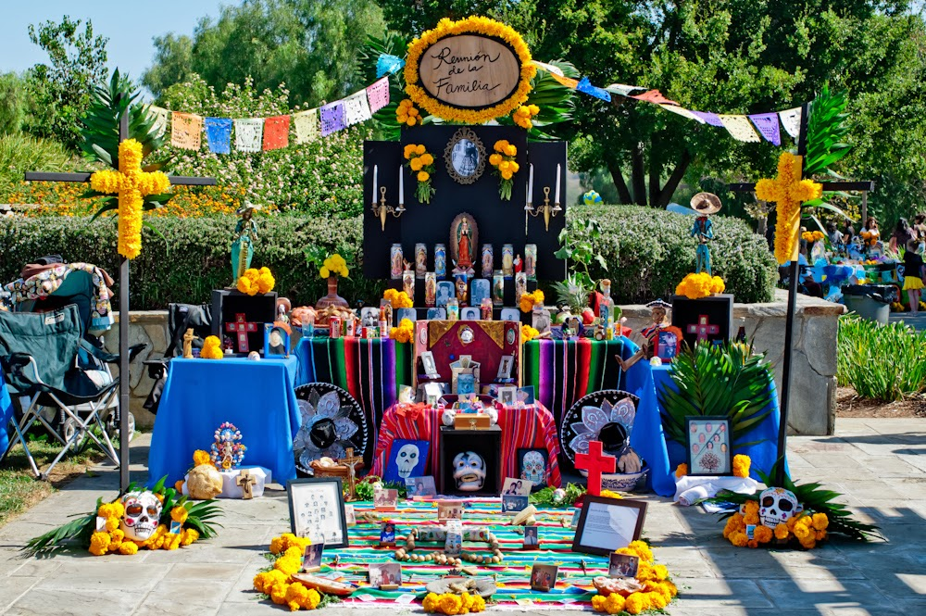
Días de los Muertos
(Days of the Dead)

Slide 2
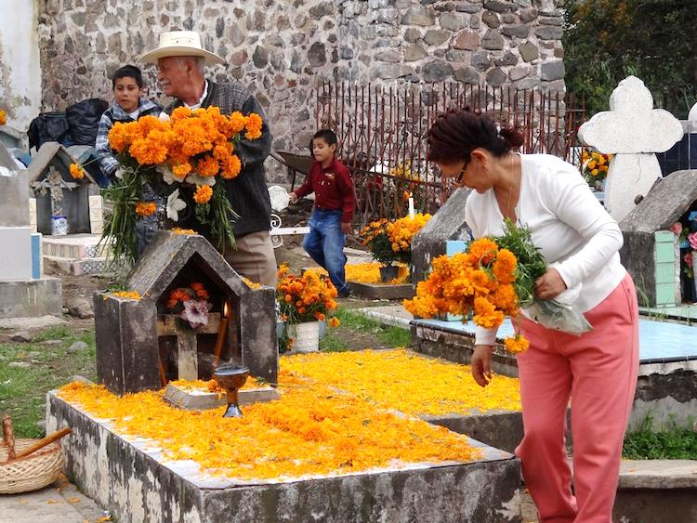

Slide 3
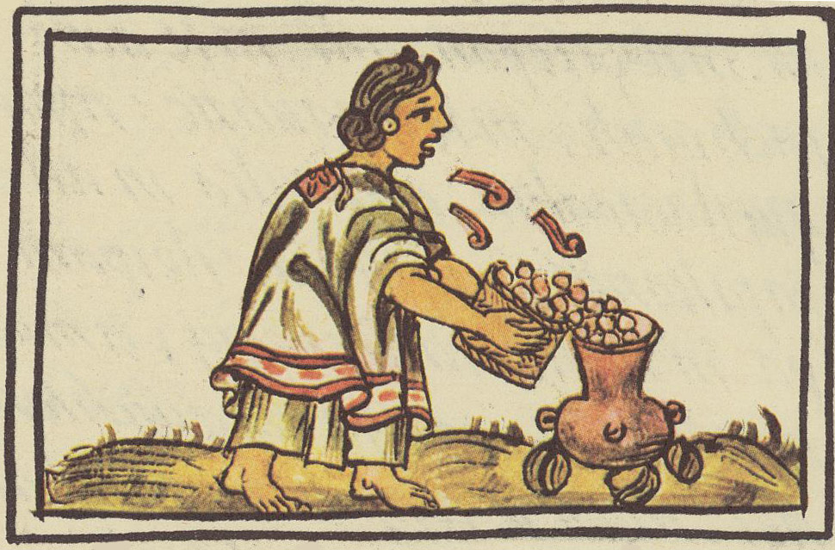
What we now know as “Day of the Dead” was originally a harvest festival!

Slide 4
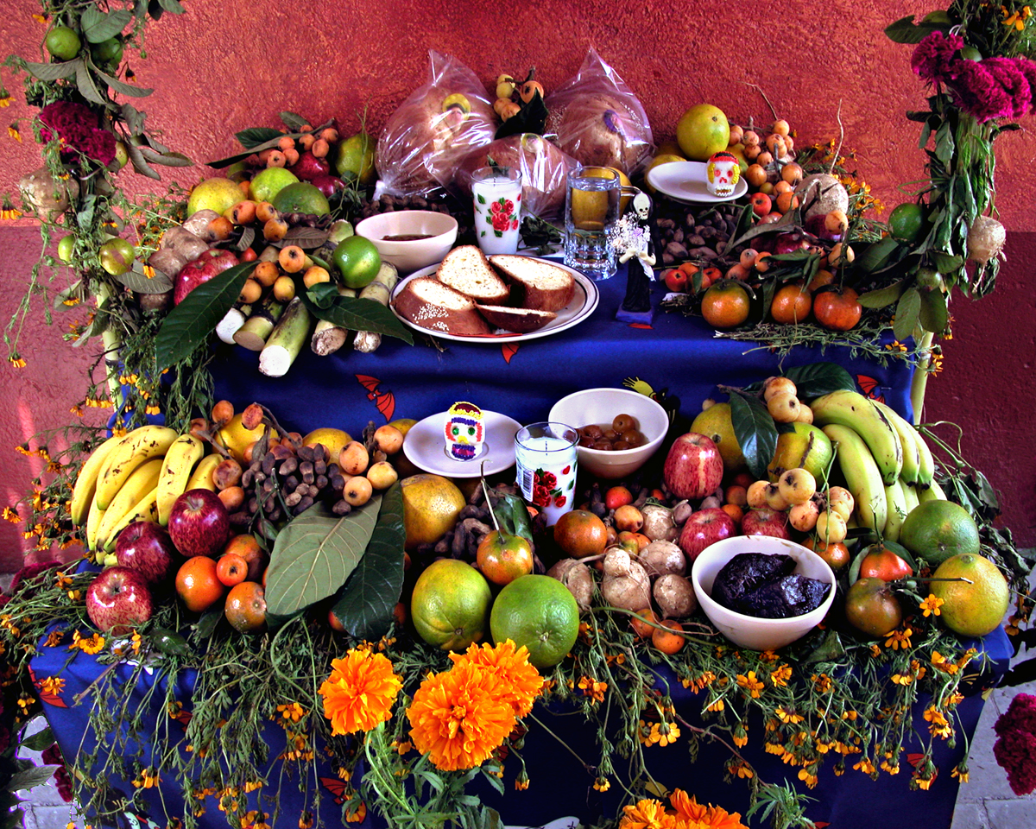
The Ofrenda (Altar)
Notes:
The altar is a literal ofrenda (offering) to the deceased spirit. It lets the spirit know it is welcome by providing all of the things that s/he enjoyed while on earth. Every altar is different and unique to the person to whom it is dedicated. Altars to children include toys and candy. Altars to adults may have their favorite indulgences.

Slide 5
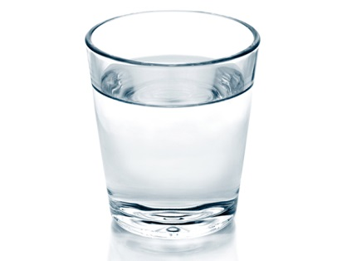
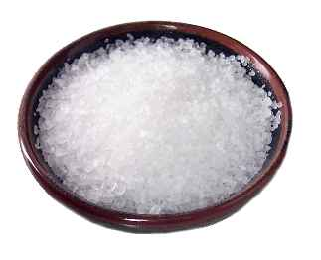
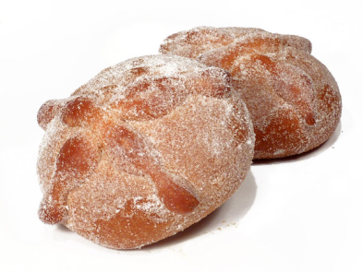
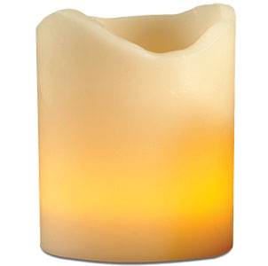
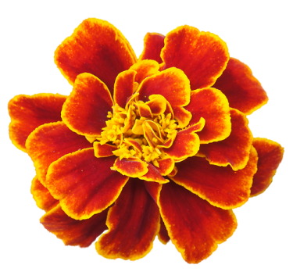
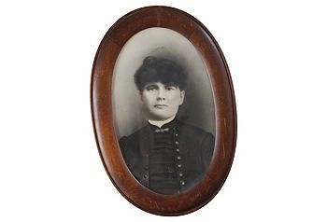
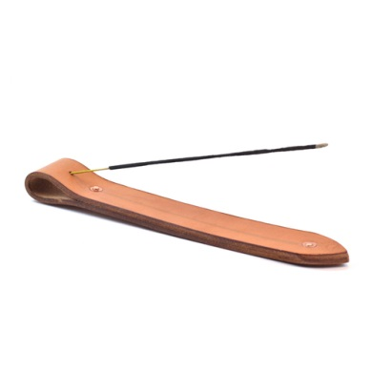
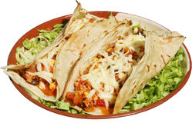
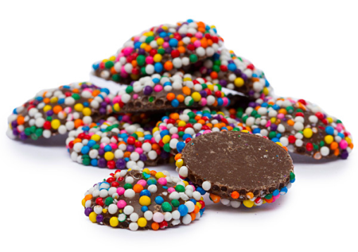
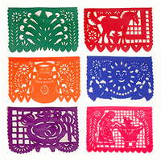
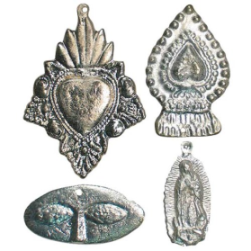
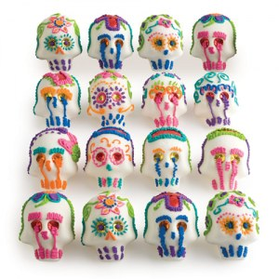
Things you find on an altar:
– WATER – – SALT – – BREAD – – CANDLES –
– Flowers – – Photos – – Incense – – Favorite foods–
– Candy – – Papel Picado – – Religious symbols – – Skulls –
Notes:
The four main elements needed for an altar are:
WATER to quench the thirst and for purification.
SALT to season the food and for purification.
BREAD to represent the food needed for survival. The bread created especially for Day of the Dead is called Pan de Muerto (Bread for the Dead)
CANDLES to guide the spirits back home.
You will also often find:
Flowers: specifically marigolds known as Cempazuchitl
Photos of the spirit
Incense: Copal is the traditional incense used. It comes from the sap of a tree and is believed to guide the spirit home when it is burned.
Favorite foods or drinks: Mole (Chocolate scented savory stew) and other aromatic dishes are prepared, again to lead the spirit home. Adult spirits are welcomed with liquors and spirits, such as tequila or mezcal.
Candy: traditional candies and sugar skulls are placed on the altar. Sweet treats are for adult spirits with a sweet tooth and child spirits.
Papel Picado: Often made at home, or purchased from a local artisan, the cut paper adds a colorful accent to altars and gravesites. Papel picado is a very traditional decoration in Mexico.
Religious symbols: milagros, statues, and pictures of saints are often used, as Day of the Dead is a religious ritual.
Skulls: The calavera is ubiquitous around the holiday. Friends trade sugar skulls with their names on them and local artisans create dioramas and sculptures showing skulls participating in daily activities such as parties, dinners, weddings and dances!

Slide 6
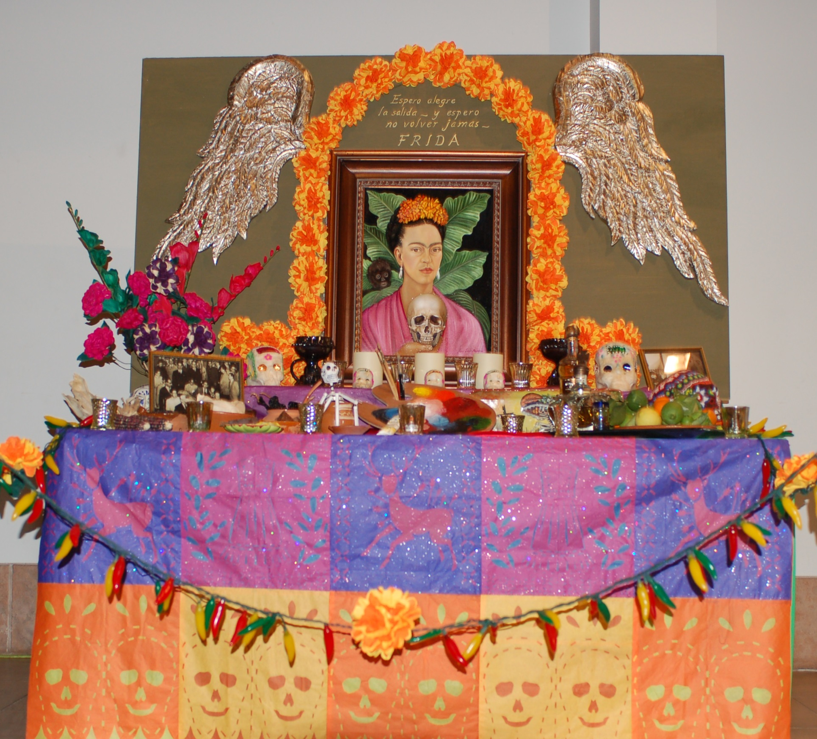

Slide 7
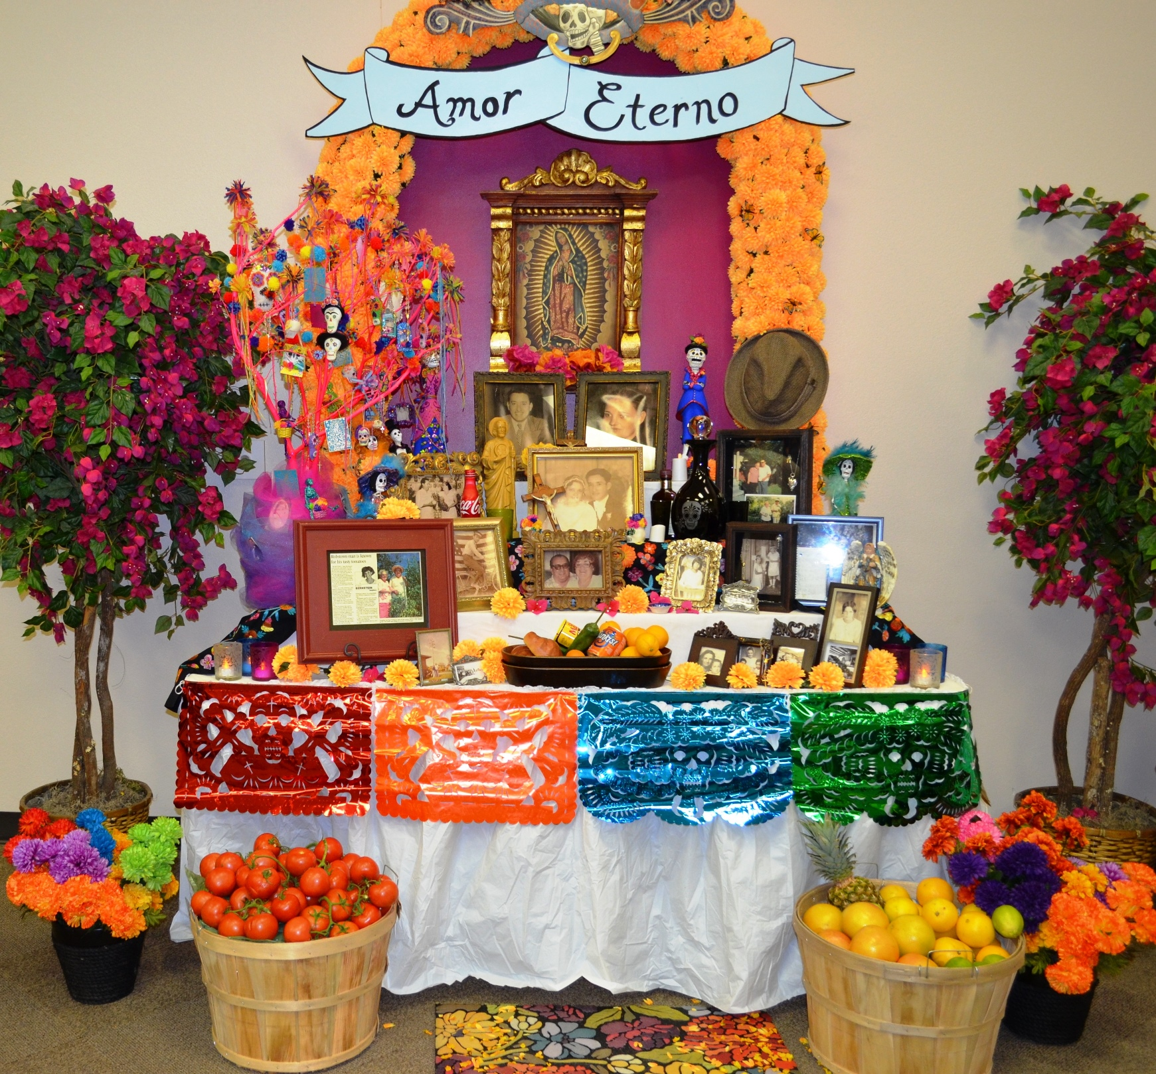
Notes:
3,000 year old tradition, some suspect it may even trace back 5,000 years!
Can be traced back to the Aztecs and
other indigenous groups
Celebrates life and death
Is *not* the same as Halloween
Over the years, Dia de los Muertos has evolved, and now Latinos in the United States celebrate it.

Slide 8
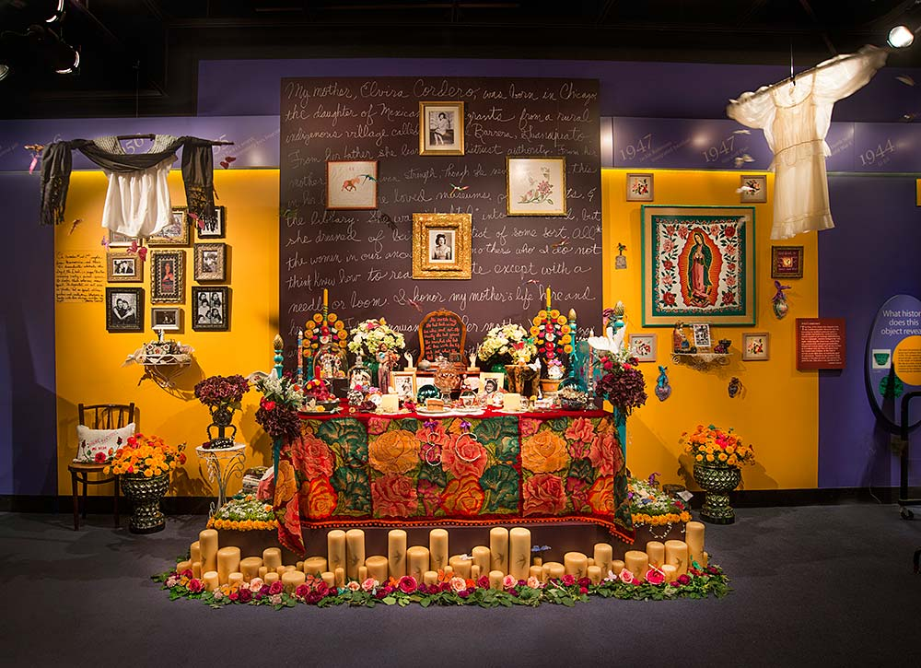

Slide 9
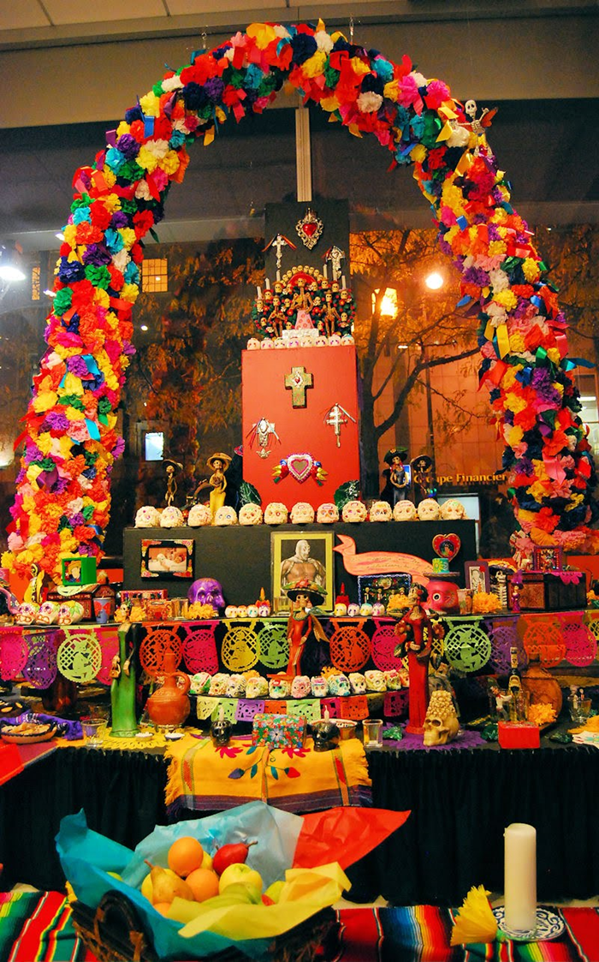
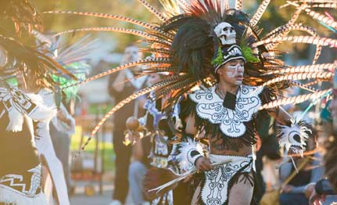
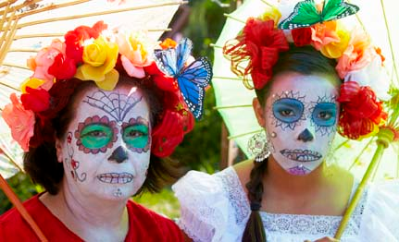
Notes:
Today, Day of the Dead is celebrated throughout the U.S. in places where big groups of Latino immigrants live. Los Angeles and Orange County host a number of Day of the Dead events at the end of October and beginning of November.
Places like the Museum of Latin American Art host altar competitions and displays where community members are invited to create altars to family members, friends, or heroes.

Slide 10
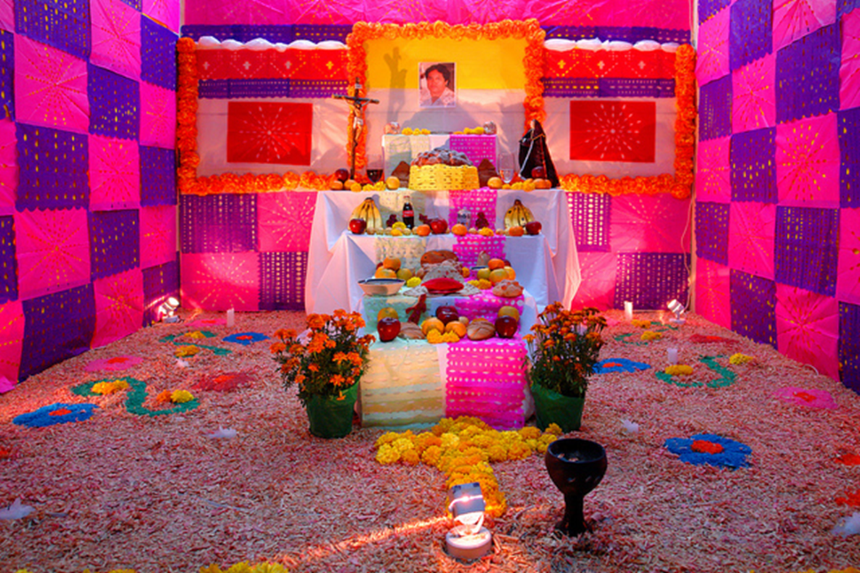
To whom would you dedicate an altar?
Friend?
Family Member?
Hero?
What objects or materials would you use to make the altar special?

