Slide 1
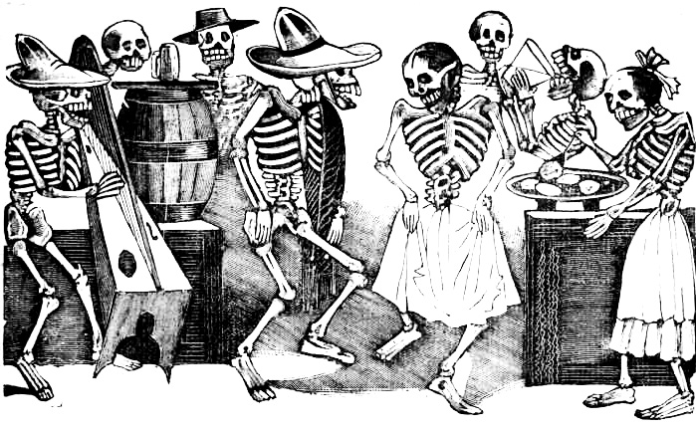
¡Calaveras!
Notes:
What is a Calavera?
This image shows the Gran Fandango (Wild Party) of the skeletons by Jose Guadalupe Posada. Calaveras are the main symbol for Dia de los muertos.
Discussion: What are the skeletons doing? How is this different from how we see skeletons during Halloween?

Slide 2
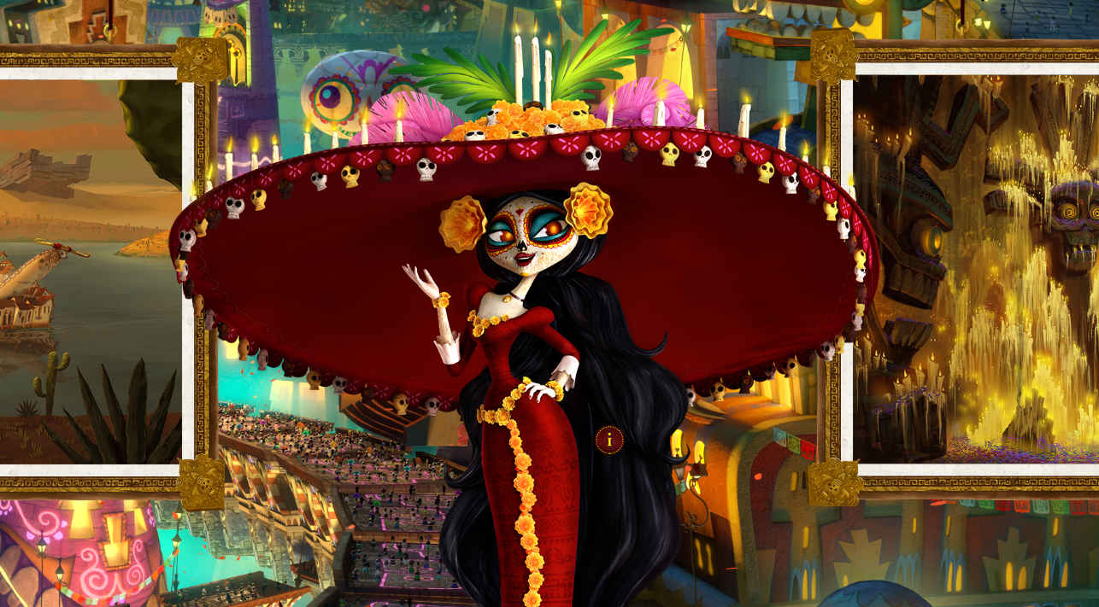
Notes:
Today, we see calaveras all around us. Do you recognize this character? She is from the film The Book of Life.
Discussion: What is she wearing? What do those items represent or symbolize? What do they say about her?

Slide 3
Where does the calavera symbol come from?
Notes:
What is a symbol?

Slide 4
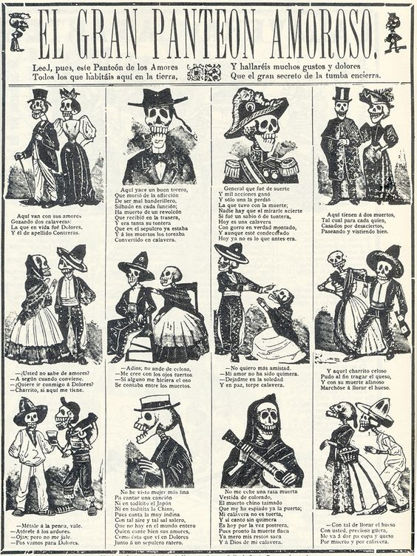
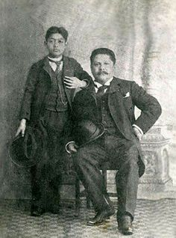
José Guadalupe Posada
(Mexico, 1852-1913)
Notes:
Jose Guadalupe Posada is one of Mexico’s earliest recognized artists. He lived and worked in Mexico City, where he created designs and illustrations for the prensa al centavo (‘penny press’), the cheap tabloids that were sold on the street.
These publications featured gruesome crime stories, gossip about politicians, ghost stories, songs, and recipes, and funny poems and rhymes. Most people couldn’t read, so the pictures were important in telling the story.
Look at the page from tabloid above. It’s called “El Gran Panteon Amoroso” (The Great Temple of Love). It shows the different types of characters and couples that one might see walking the streets of Mexico City.

Slide 5
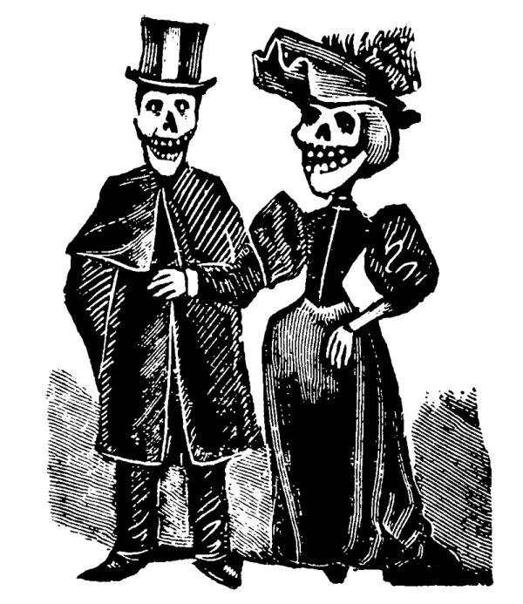
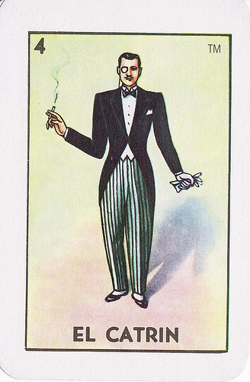
Notes:
One of the illustrations is of an upper-class couple. They are shown in fancy outfits and hats. Their clothing reflects their social status. Jose Gu
The ryhme beneath them reads:
Aqui tienen a dos muertos / Here you have two dead people
Tal cual para cada quien / To each their own
Casados por desaciertos / Married for being oddballs
Paseando y vistiendo bien / Strolling and dressed to impress

Slide 6
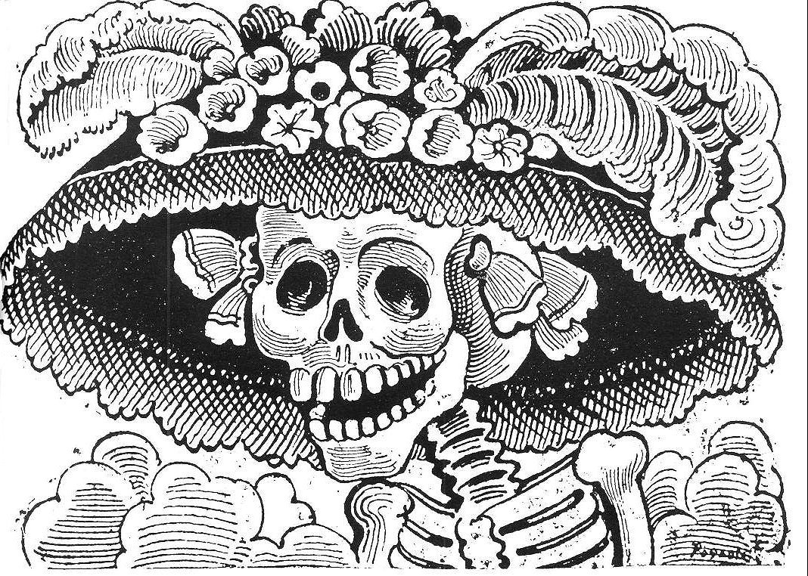
La Calavera Catrina

Slide 7
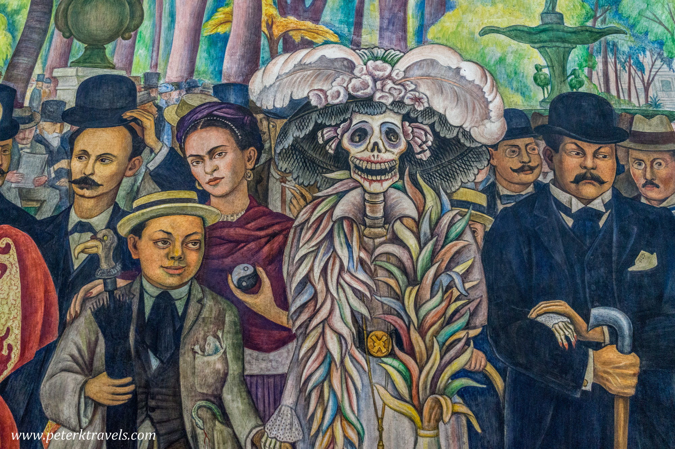

Slide 8
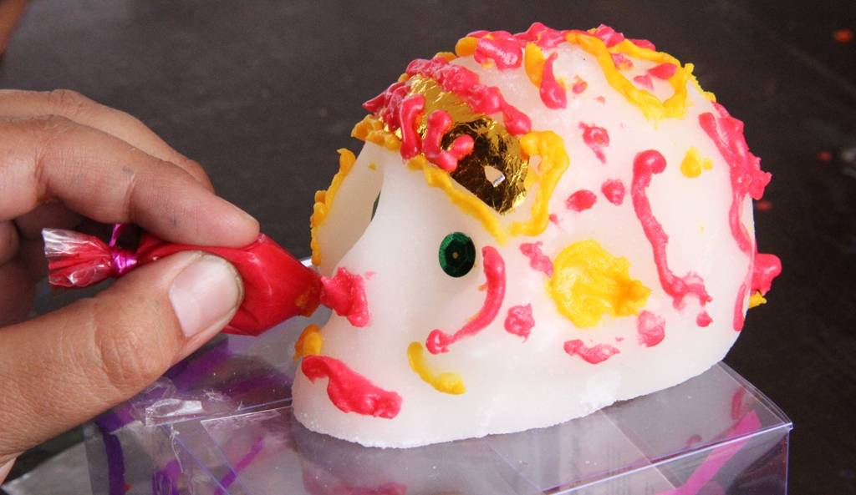
Sweet Calaveras : Sugar Skulls
Notes:
Sugar skulls are made by pouring a mixture of sugar, meringue powder, and a little water. The mixture is pressed into a plastic mold and allowed to set. When the skull has set, it is pushed out of the mold and allowed to dry. Once the skull is ready, it is decorated with icing, foil, and feathers. You usually see people’s names written on the skulls, too. It is considered thoughtful to give someone a sugar skull with their name on it!
The sugar skull is the direct result of European practices blending with indigenous American traditions, too!

Slide 9
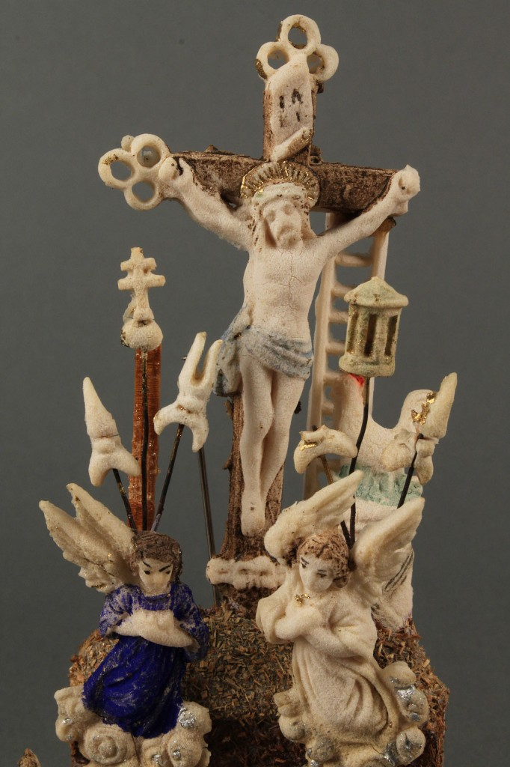
Artist unknown
Sugar sculpture from the 1800s
Notes:
Sugars decorations began being produced in the Americas in the late 1600s, about 150 years after the Spanish invasion.
The practice came to the Americas via Italian missionaries. Indigenous and Mestizo artisans learned to create inexpensive religious decorations from sugar, which was plentiful in the Americas. Back then, they used clay molds.

Slide 10
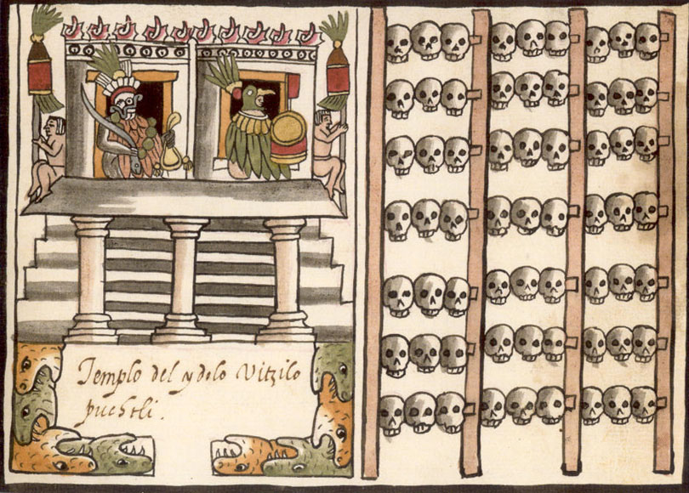
Mexica, 1587
Tzompantli at a temple dedicated to Huitzilopochtli, the god of war
from Codex Tovar
Notes:
Skulls were very important to indigenous American cultures. The Mexica (along with other indigenous American civilizations) decorated their temples with the skulls of sacrificed captured warriors from other groups. The skull rack in this image is called a Tzompantli (som-PAN-Tlee).
The skulls were representative of the offerings they made to their gods through human sacrifice.

Slide 11
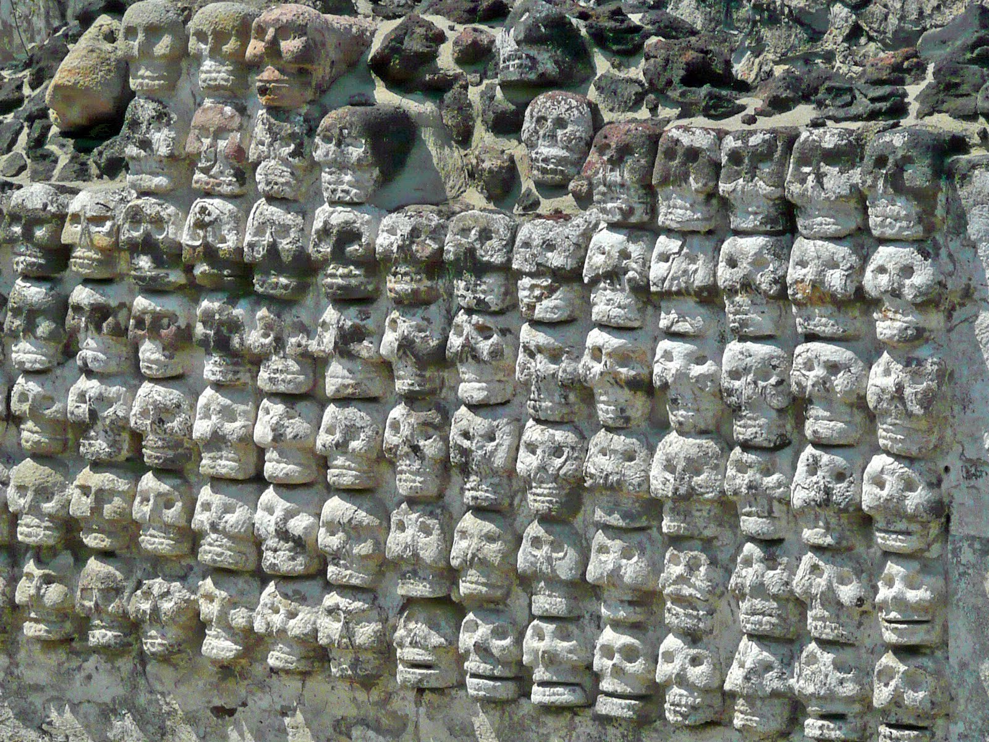
Stone Tzompantli at Templo Mayor, Mexico City
Notes:
Stone depictions of Tzompantli can be found in various ruins throughout Mexico. It shows the importance of making offerings to their gods. The skull is one of the symbols that was carried over into Day of the Dead from the original Mexica traditions.

Slide 12
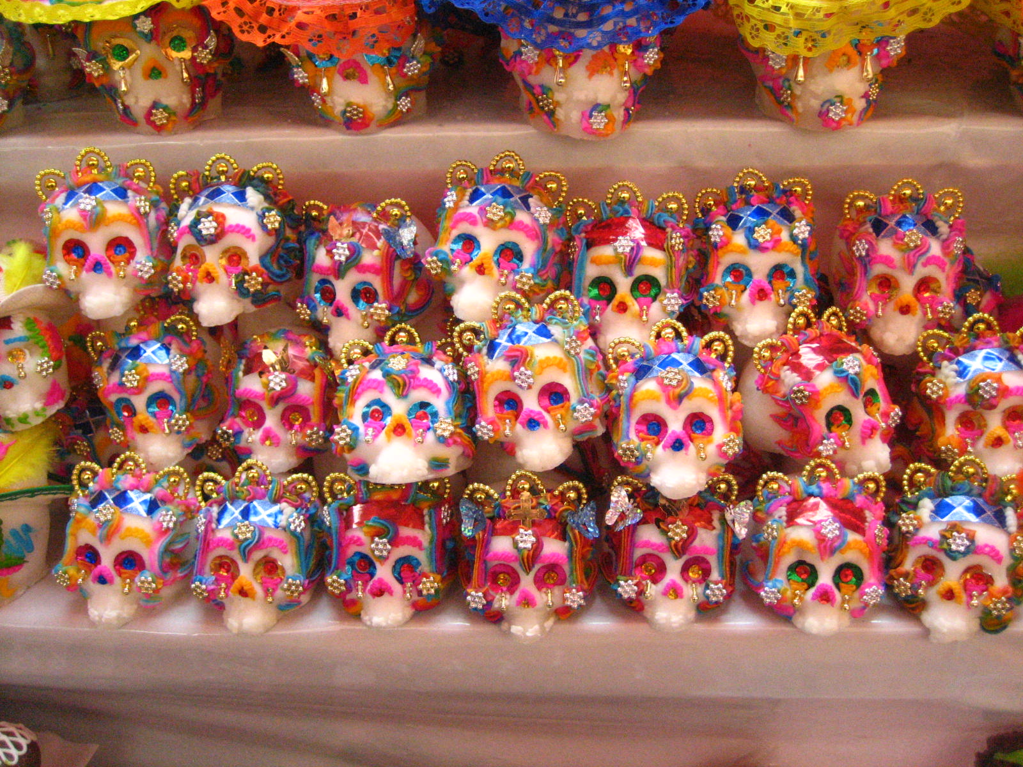
Notes:
No one knows who first began decorating ofrendas with sugar skulls. It’s a tradition that we can only speculate about. We can assume that it began almost immediately after sugar decorations were introduced, which would mean that it began pretty much as soon as Day of the Dead as we now know it began in the Americas.
The memories of Tzompantlis as offerings may have been fresh in the artisans’ minds. Perhaps they used the skulls to keep part of their ancient traditions alive? Perhaps they were still worshipping their ancient gods in secret. We’ll never really know.

Slide 13
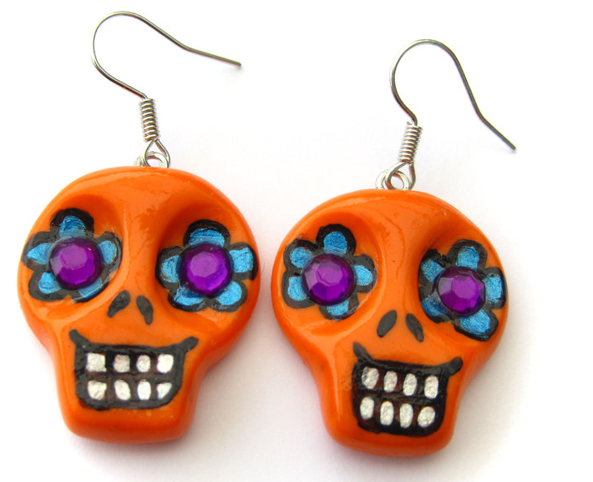
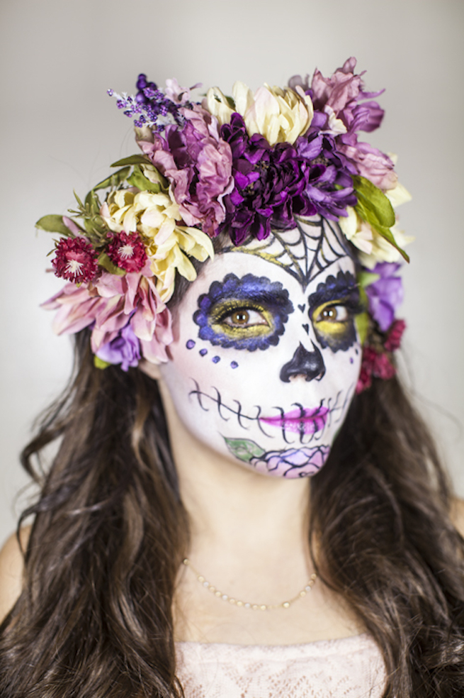
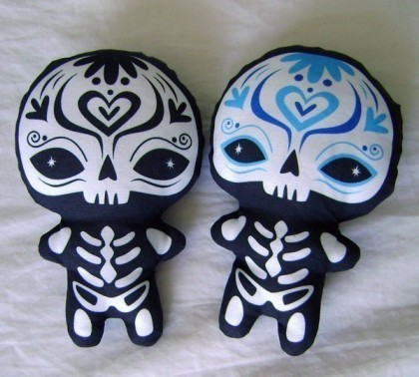
Notes:
Today, the sugar skull is the main symbol for Day of the Dead. People paint their faces like sugar skulls and decorate objects and clothing with the smiling skeleton.

Slide 14
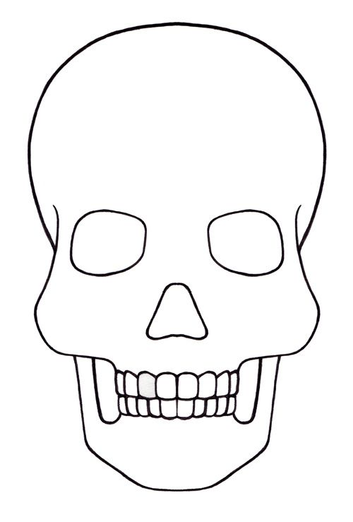
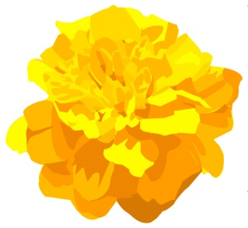
If you could give a sugar skull to anyone, who would it be?
???
Notes:
In Mexico, Sugar Skulls are exchanged by friends and family members as a humorous token of friendship. The name of the recipient is written in frosting across the forehead on a foil sheet.
Questions to ask: How would you feel if someone gave you a sugar skull? How is this skull different from the ones you see at halloween?

